Slide 1
The Work of Rivers
The erosional work of streams/rivers carves and shapes the landscape through which they flow.
3 functions of rivers
Erosion
Transportation
Deposition

Slide 2
The Work of Rivers
Erosion
A river may erode in 4 ways
Abrasion/corrasion
Load carried by a river will grind against its bed and sides.
This process slowly wears the bed and sides away.

Slide 3
The Work of Rivers
Erosion
2. Attrition
When thrown against the sides and bed of rivers, the load gets broken into smaller pieces.

Slide 4
The Work of Rivers
Erosion
3. Hydraulic action
The work of turbulence in the water.
Running water causes friction in the joints of rocks in a stream channel
Joints may be enlarged
Loosened fragments of rocks get swept away.

Slide 5
The Work of Rivers
Erosion
4. Solution/Corrosion
Certain minerals in rocks like limestone can be dissolved in water.
Rocks are then eroded.

Slide 6
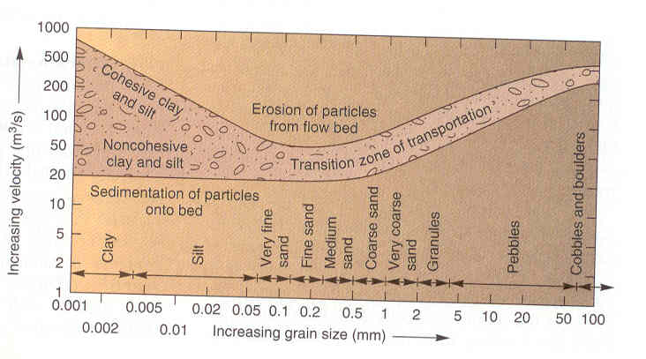
The Work of Rivers
Relationship of velocity and sediment size to erosion

Slide 7
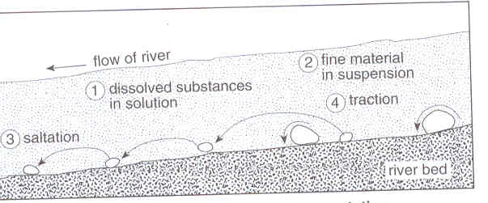
The Work of Rivers
B. Transportation (4 ways)

Slide 8
The Work of Rivers
B. Transportation (4 ways)
Traction
Larger and heavier rocks/gravels are dragged or rolled along the bed.

Slide 9
The Work of Rivers
B. Transportation (4 ways)
2. Saltation (saltim: by leaps/jumps)
Smaller and lighter rock fragments and sand hop and bounce along the river bed.
At times, the distinction between traction and saltation may be difficult to determine.

Slide 10
The Work of Rivers
B. Transportation (4 ways)
3. Suspension
Some of the load like silt and clay (fine-grained) will float along.
They may only be deposited when stream velocity reaches near 0.
Turbulence in the water is crucial in holding a load of sediments.

Slide 11
The Work of Rivers
B. Transportation (4 ways)
4. Solution
Some minerals are transported in dissolved form.
Especially chemical solution derived from minerals like limestone or dolomite.

Slide 12
The Work of Rivers
C. Deposition
A river will drop its load when:
Volume decreases
Speed decreases

Slide 13
The Work of Rivers
C. Deposition
A river’s volume decreases when
Dry season
Dry region with high evaporation
Presence of permeable rocks
Receding flood waters

Slide 14
The Work of Rivers
C. Deposition
A river’s speed decreases when
It enters a lake
It enters a calm sea
It enters a gently sloping plain

Slide 15
The Work of Rivers
The work of a river depends on its energy
Energy a function of
Volume of water
Speed of water flow (dependent on gradient)

Slide 16
This powerpoint was kindly donated to www.worldofteaching.com
http://www.worldofteaching.com is home to over a thousand powerpoints submitted by teachers. This is a completely free site and requires no registration. Please visit and I hope it will help in your teaching.

